Slide 1
FINAINCIAL SENTIMENTS
MENTOR – Neha Gupta
PROJECT BY:
Mr. Danuka Greeshmanth
Ms. Divya Mahendra Wandhare
Ms.Chitlangiya Chhaya Sawarmal
Ms.Pal Meera Dinanath
Mr Digvijay Sandip Gavhane
Kalavala Rajeev Gagan

Slide 2
INTRODUCTION
Sentiments are feelings, opinions, emotions, likes/dislikes, good/bad
Sentiment Analysis is a Natural Language Processing and Information Extraction task that aims to obtain writer’s feeling expressed in positive or negative comments, questions and requests, by analyzing a large number of documents
Sentiment analysis is a study of human behavior in which we extract users opinion and emotion from plain text
Sentiment Analysis is also known as Opinion Mining

Slide 3
BUSINESS PROBLEM
Need to get sentiment analysis of financial statements and gauge its impact i.e. positive, negative or neutral on the business and government.

Slide 4
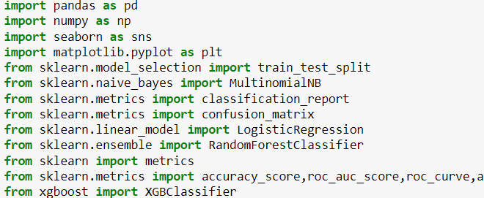
Here the list of required Python libraries
Imported PANDAS for doing data modeling, data analysis and data manipulation.
Imported NUMPY to perform a wide variety of mathematical operations on arrays.
Imported SEABORN to visualize random distributions.
Imported MATPLOTLIB as it displays numeric data in the form of plots, graphs, and charts in Python.
Imported SKLEARN as it lets to perform various Machine Learning tasks and provides a means to implement Machine Learning in Python.

Slide 5
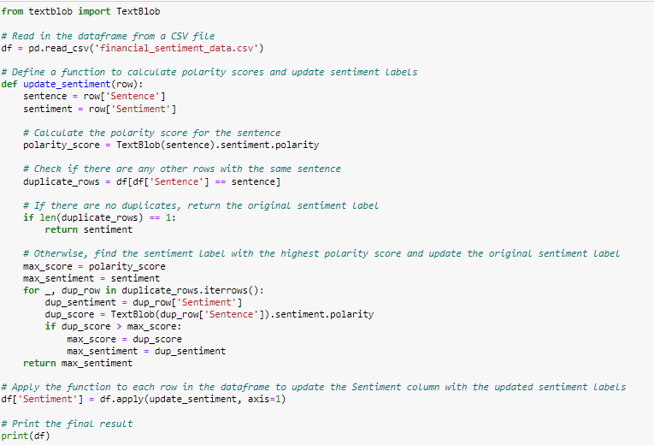

Slide 6
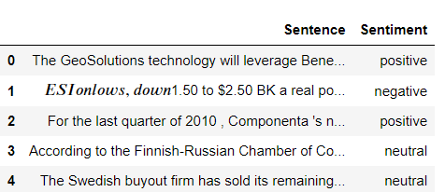
The following is the Data Set which we would be working on

Slide 7
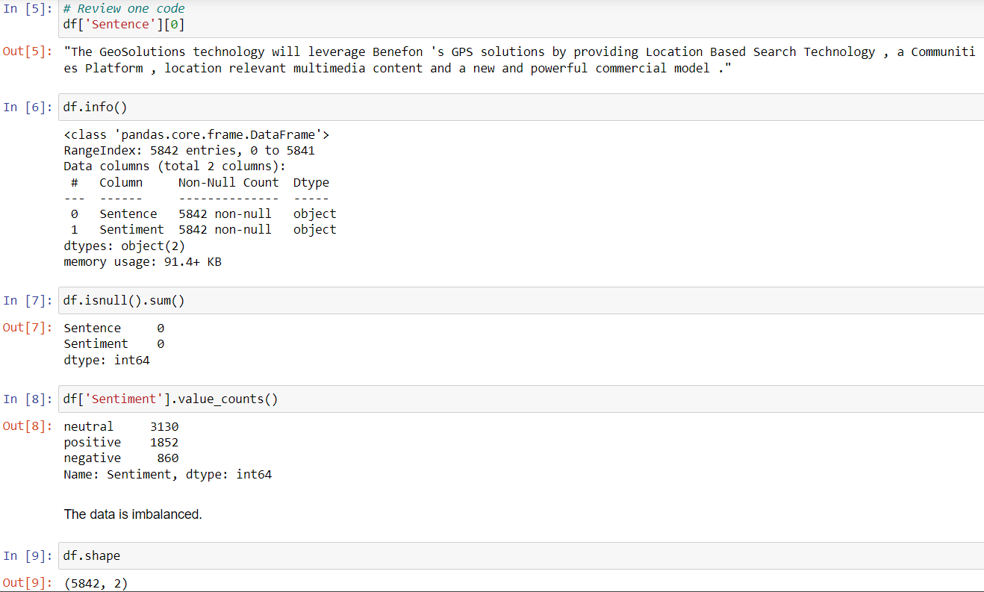
Exploratory Data Analysis
The following are the steps which we used for EDA
Exploratory Data Analysis - EDA.
Load the Data.
Basic information about data - EDA.
Duplicate values.
Unique values in the data.
Visualize the Unique counts.
Find the Null values.
Replace the Null values.

Slide 8
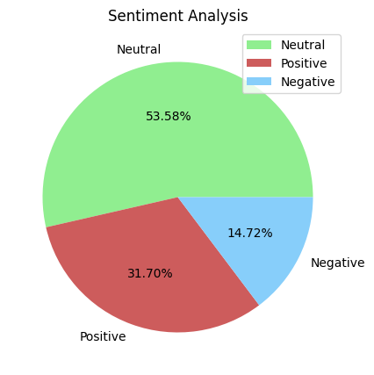
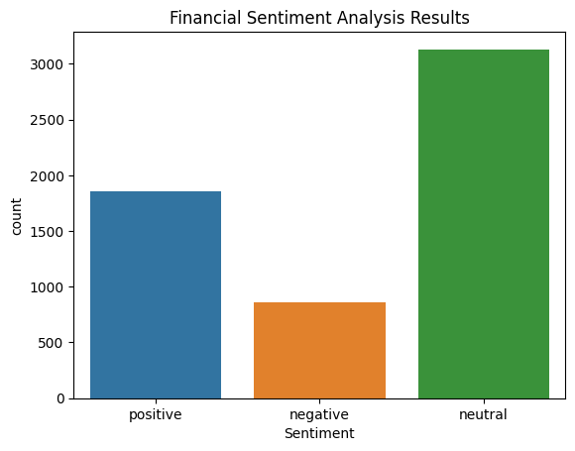
CONCLUSION
We hereby come to a conclusion as there are 53.58% of neutral data14.72% of Negative Data and 31.70% of Positive Data

Slide 9
WORD CLOUD
A word cloud is a technique to show which words are the most frequent in the given text. We can use a Python library to help us with this. The first thing you may want to do before using any functions is to check out the docstring of the function and see all required and optional arguments.
Word clouds are great for visualizing unstructured text data and getting insights on trends and patterns.
Advantages of Word Clouds :
1)Analyzing customer and employee feedback.
2)Identifying new SEO keywords to target.

Slide 10
FREQUENCY
We are finding frequency of word which are in each of sentence in order to get the useful and non-useful words . So that we can remove the non-usefull words

Slide 11
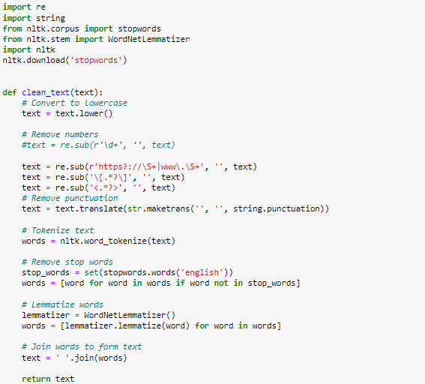
TEXT MINING
Text Preprocessing;
A large number of documents that contain unstructured and semi-structured data, text preprocessing is applied on it and transforms a raw text file into clearly-explained sequence of linguistically-meaningful units. Text preprocessing incorporates various kind of processing as following
Text Cleanup: It processes various tasks such as from removing advertisements from web pages to cutting out tables and figures, etc.
Tokenization: It makes segmentation of sentences into words by erasing spaces, commas etc.
Filtering: It extricates the words that have no relevant content-information including articles, conjunctions, prepositions, etc. Even the words of frequent repetitions are also removed.
Stemming: It is the process of transforming words to its stem,or normalized form by making basic forms of words to recognize words by its root word-forms. For example, the word “go” is the stem goes, going and gone.
Lemmatization: It reorganizes the word to correct root linguistically, that is the base form of the verb. During the entire process, the first step is to understand the context, and finds out the POS of a word in a sentence and at last identifies the ‘lemma’. For example, go is the lemma of goes, gone, going, went.
Linguistic processing: Involving Part-of-speech tagging (POS), Word Sense Disambiguation (WSD) and Semantic structure, it works as follow as

Slide 12
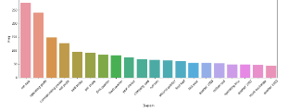
N-GRAMS
N-grams of texts are extensively used in text mining and natural language processing tasks. They are basically a set of co-occurring words within a given window and when computing the n-grams you typically move one word forward (although you can move X words forward in more advanced scenarios).
BI-GRAMS
In Bigram we assume that each occurrence of each word depends only on its previous word. Hence two words are counted as one gram(feature) here.
That’s the reason we are using BIGRAM

Slide 13
LABEL ENCODER
This approach is very simple and it involves converting each value in a column into a number. Consider a dataset having many more columns, to understand label-encoding, we will focus on one categorical column only i.e. State which is having below values
We have consider as:
0= Negative
1= Neutral
2= Positive

Slide 14
TFIDF - Term frequency inverse Document Frequency
Inverse Document Frequency (TF-IDF) is a widely used statistical method in natural language processing and information retrieval. It measures how important a term is within a document relative to a collection of documents (i.e., relative to a corpus). Words within a text document are transformed into importance numbers by a text vectorization process. There are many different text vectorization scoring schemes, with TF-IDF being one of the most common.
As its name implies, TF-IDF vectorizes/scores a word by multiplying the word’s Term Frequency (TF) with the Inverse Document Frequency (IDF).

Slide 15
MULTINOMIAL NAIVE BAYES
Multinomial Naive Bayes algorithm is a probabilistic learning method that is mostly used in Natural Language Processing (NLP). The algorithm is based on the Bayes theorem and predicts the tag of a text such as a piece of email or newspaper article. It calculates the probability of each tag for a given sample and then gives the tag with the highest probability as output.
Naive Bayes classifier is a collection of many algorithms where all the algorithms share one common principle, and that is each feature being classified is not related to any other feature.

Slide 16
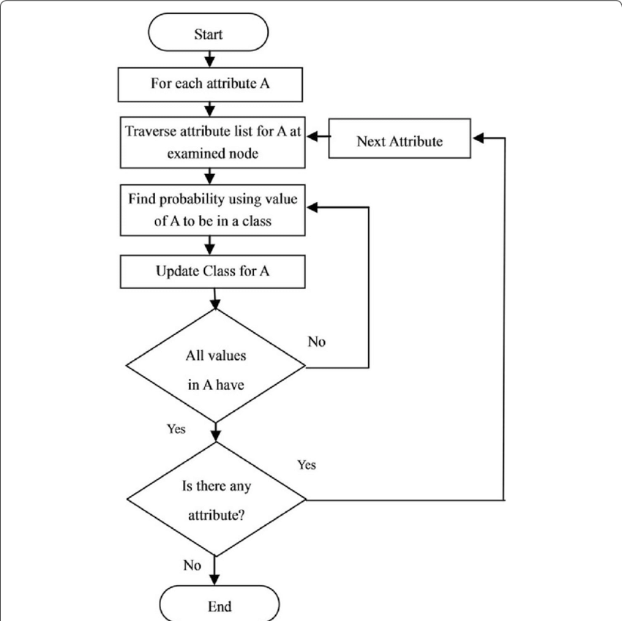

CLASSIFICATION REPORT AND FLOWCHART

Slide 17
RANDOM FOREST
Random Forests were introduced by Leo Breiman ,who was inspired by ear-lier work by Amit and Geman ,Random Forests are an extension of Breiman’s bagging idea and were developed as a competitor to boosting. Random Forests can be used for either a categorical response variable, referred to in as “classiﬁcation”, or a continuous response, referred to as “regression”. Similarly, the predictor variables can be either categorical or continuous.
From a computational standpoint, Random Forests are appealing because they
•naturally handle both regression and (multiclass) classiﬁcation;
•are relatively fast to train and to predict;
•depend only on one or two tuning parameters;
•have a built in estimate of generalization error;
•can be used directly for high-dimensional problems;
•can easily be implemented in parallel.

Slide 18

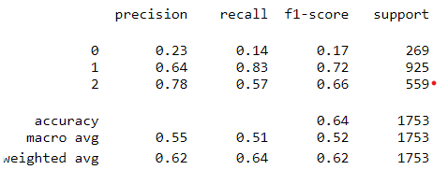
CLASSIFICATION REPORT AND FLOWCHART

Slide 19
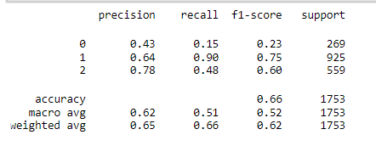
XGBoost
XGBoost is also a boosting algorithm in machine learning which is an extreme version of gradient boosting. In gradient boosting, there is no implementation of regularization, whereas XGBoost is a regularized form of gradient boosting algorithm, where L2 or L1 regularization is already implemented.
The following is the CLASSIFICATION REPORT OF XGBoost of our data

Slide 20
K-Nearest Neighbors
The k-nearest neighbors algorithm, also known as KNN or k-NN, is a non-parametric, supervised learning classifier, which uses proximity to make classifications or predictions about the grouping of an individual data point. While it can be used for either regression or classification problems, it is typically used as a classification algorithm, working off the assumption that similar points can be found near one another.

Slide 21
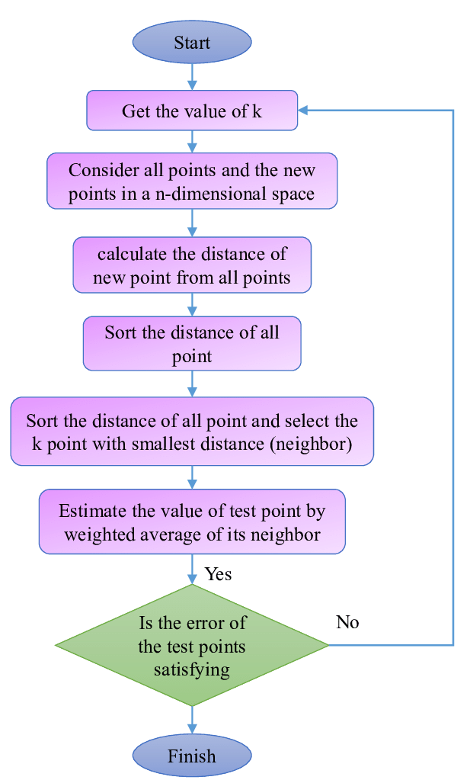
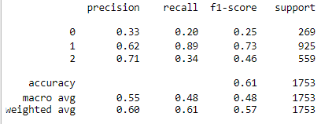
CLASSIFICATION REPORT AND FLOWCHART

Slide 22
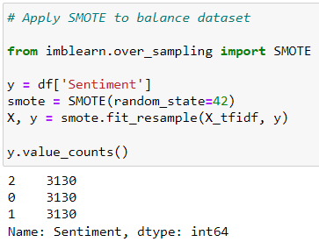
SMOTE
Synthetic Minority Oversampling Technique (SMOTE) is a statistical technique for increasing the number of cases in your dataset in a balanced way. The component works by generating new instances from existing minority cases that you supply as input.

Slide 23
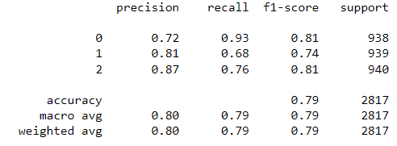
Multinomial Naive Bayes
The multinomial naïve Bayes is widely used for assigning documents to classes based on the statistical analysis of their contents. It provides an alternative to the "heavy" AI-based semantic analysis and drastically simplifies textual data classification.
The classification aims to assign fragments of text (i.e. documents) to classes by determining the probability that a document belongs to the class of other documents, having the same subject
We have used Multinomial Naive Bayes as it was giving the highest accuarcy
The following is the classification report we have obtained

Slide 24
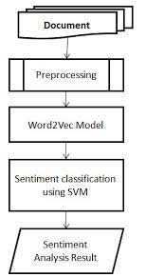
Word2vec
FOLL0WING IS THE FLOWCHART OF Word2Vec:
Word2Vec is a machine learning technique that has been around since 2013, courtesy of Tomas Mikolov and his data science team at Google. It relies on deep learning to train a computer to learn about your language (vocabulary, expressions, context, etc.) using a corpus (content library).

